Slide 1

Transferring Your Data

Slide 2
Brandon Reyes
email: brre2566@colorado.edu
RC Homepage: https://www.colorado.edu/rc
Slides available on GitHub:
Summer_Camp_2023/Day_Two/Transferring_your_data/slides

Slide 3
Outline
Ways to access your data
Data transfer using the command line
Data transfer using Open OnDemand
Data transfer using Globus
Sharing Data
Getting A Petalibrary Allocation

Slide 4
Accessing Data on RC Resources
When you use RC resources the data is not on your local machine
Ways to access the data from your local machine
Command line (a variety of tools)
Open OnDemand (straightforward GUI interface)
Globus (GUI interface with some set up required)

Slide 5
Access through the Command Line
If you don’t need a fancy GUI
Provides a larger variety of tools
SCP
SFTP
RSYNV
RCLONE
SSHFS
SMB
The tools provided can improve your data workflow (more on this later)

Slide 6
General Filesystem Structure
/home (2GB) | /projects (250GB) | /scratch/alpine (10TB)
Small important data Backed up frequently Not for sharing files or job output | Medium sized important data Software Can be shared with others Backed up, but less frequently Not for job output | Large data Can be shared with others Fast Data transfer to compute nodes Not backed up! Purged after 90 days!
Filesystem documentation: https://curc.readthedocs.io/en/latest/compute/filesystems.html

Slide 7
Let’s get on a login node!
ssh <your-username>@login.rc.colorado.edu

Slide 8
RC Filesystem Map
/
/home
/projects
/scratch
/pl
/your-username
/your-username
/alpine
/active
/archive
/your-username
/your-pl-allocation
/your-pl-allocation
You start here!

Slide 9
Basic Navigation Commands
Change directories
List contents of a directory
Print current working directory
cd <relative-or-full-path>
ls <optional-path>
pwd

Slide 10
RC endpoints
Endpoint – one of the two file transfer locations i.e., it is either the source or the destination we want to copy data from or to.
For data on RC resources, we have two endpoints
The login* nodes
Only use for small transfers!!
Data transfer nodes (DTNs)
CSU
<your-username>@login.rc.colorado.edu
<your-username>@dtn.rc.int.colorado.edu
<your-username>@dtn.rc.colorado.edu

Slide 11
RC Data transfer nodes (DTNs)
Command line use of DTNs only available if you are on CU Boulder or CSU’s network or VPN
Dedicated nodes for transferring data
Faster transfers
More stable transfers
Suitable for
Large and frequent transfers
Automated (passwordless) transfers
Only for CU Boulder folks
Cannot ssh into the DTNs!

Slide 12
Command line option - SCP
SCP (Secure Copy Protocol) is a command line tool to transfer files/directories to, from, or between remote locations.
Simple, but useful!
Copying a local file to RC resources using a login node:
Copying a directory from RC resources to local path via a DTN:
scp file1 <username>@login.rc.colorado.edu:<remote-path>
scp –r <username>@dtn.rc.int.colorado.edu:<path-to-directory> <local-path>

Slide 13
Command line option - SFTP
SFTP (Secure File Transfer Protocol) a command line tool that is similar to SCP, but provides an sftp session where both the local and remote filesystems are available
Slightly more advanced than SCP
Useful for multiple file/directory transfers
Starting a SFTP session on a local machine
Demo time!
sftp <username>@login.rc.colorado.edu

Slide 14
Command line option - Rsync
Rsync (remote sync) a command line tool that offers remote and local file synchronization.
Only copies the portion of the files that have changed!
Already installed on most Linux distributions and macOS
Needs to be installed on Windows
Sync RC resources to local computer
Flags:
-v # verbose mode
-a # archive mode
rsync -av <username>@login.rc.colorado.edu:<remote-path> <local-path>

Slide 15
Command line option - Rclone
Rclone is a command line tool used to manage files on cloud storage.
It is compatible with all major cloud storage solutions
Supported by over 40 cloud storage products!
Created as a cloud equivalent to the UNIX commands:
rsync, cp, mv, mount, ls, ncdu, tree, rm, and cat
Needs to be downloaded on your local machine
Requires a more involved setup process but works great!
https://curc.readthedocs.io/en/latest/compute/data-transfer.html#rclone
rclone copy rclonetest.csv aws_s3:testbucket/

Slide 16
Command line option - mounting
Mounting is the process of attaching a file system to a directory on another system.
SSHFS (secure shell filesystem)
Needs to be installed on Mac and Windows (available on most Linux distributions)
You need to be on the campus network or VPN!
SMB (server message block)
Built into all major operating systems
You need to be on the campus network or VPN!
Contact us if you want to use this
sshfs <username>@login.rc.colorado.edu:<path> <local-mountpoint>

Slide 17
GUI based options

Slide 18

GUI option - Open OnDemand
No command line required!
http://ondemand.rc.colorado.edu/
http://ondemand-rmacc.rc.colorado.edu/
File management
Create, Delete, Move, and Rename
File transfers
Upload and Download

Slide 19
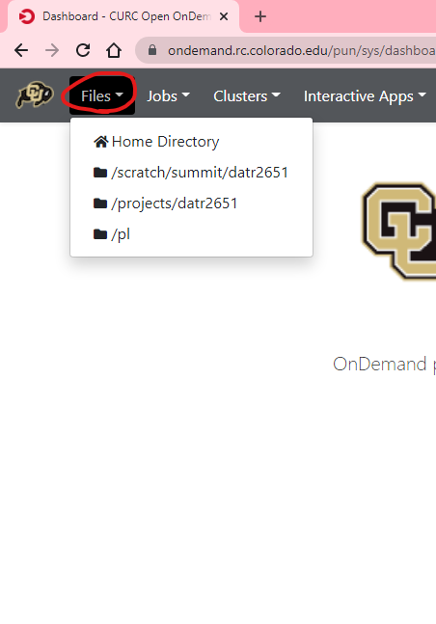
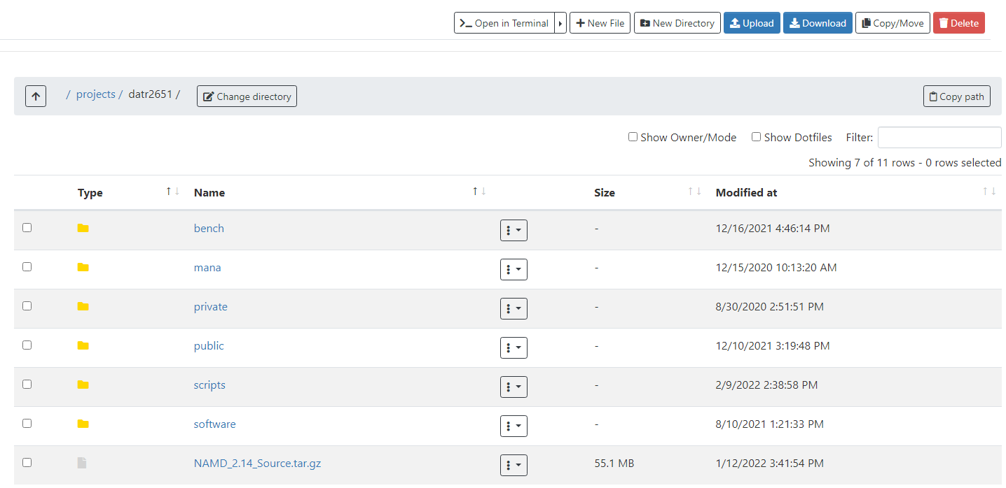

Slide 20
Let’s take a look!

Slide 21

GUI option - Globus
Globus is a service that allows for users to reliably move, share, and discover data
There does exists a command line version (not covered here)
Our recommended way to transfer data
Stable and fast data transfers
Transfers continue if a user disconnects
Web GUI or Globus Connect Personal GUI
Supported on all major operating systems
Works well with cloud storage providers

Slide 22
Globus Demo
Globus login is simple and quick: https://app.globus.org
CU Boulder users - select “University of Colorado at Boulder” in the dropdown menu
Other institutions should select “ACCESS”
Login with your credentials
Continue with onscreen prompts until you are brought to the Globus WebGUI
Installing a Globus Endpoint on your local machine
Required if you want to transfer data to your machine
Navigate to https://www.globus.org/globus-connect-personal
Click on operating system specific version and follow install instructions

Slide 23
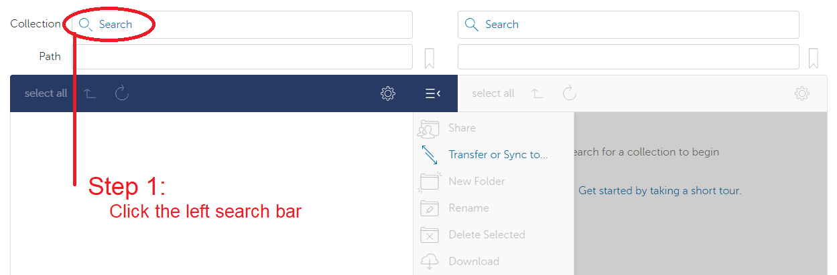
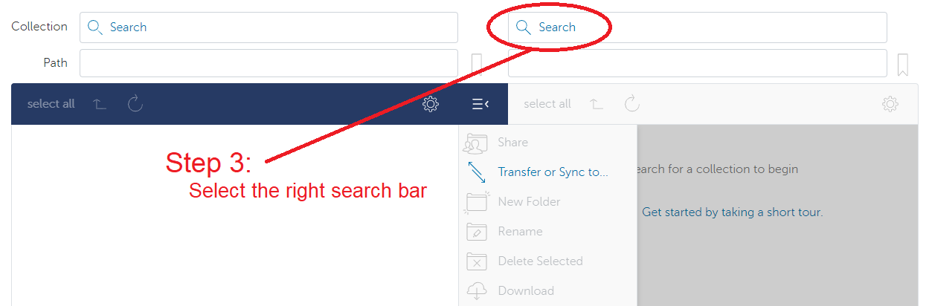
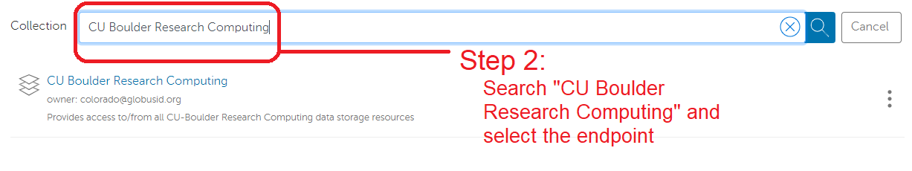
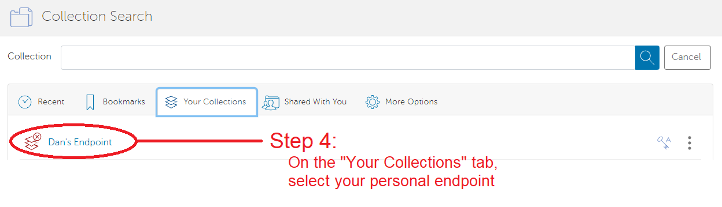

Slide 24
Let’s check it out!

Slide 25
The Petalibrary
The PetaLibrary is a CU Boulder Research Computing service
Expands the amount of storage space available to you
Aims to work seamlessly with all RC resources
Supports the storage, archival, and sharing of data
Available at a subsidized cost for researchers affiliated with University of Colorado
New customer’s initial upper limit:
200 TB for Active storage (available to compute resources)
100 TB for Archive storage (not available to compute resources)

Slide 26
Sharing Data
Other RC Users
To share files that you own with other RC users, contact RC with a list of users you would wish to allow access
RC will place the chosen users in the owner’s group
The owner can then set up permissions in the space
On-premise collaborators can also access Petalibrary files with Globus Shared Endpoints
Off-premise collaborators
Off-premise collaborators can only access Petalibrary files through Globus Shared Endpoints

Slide 27
Unix Groups
Unix Groups
3 Levels of permissions:
User
Group
Other
All users have a group associated with their username
Permissions can be set for an individual file with the chmod command
chmod g+rx file.exe

Slide 28
Globus Shared Endpoints
Globus offers ‘shared endpoints’ which don’t require a user to have an account with RC.
RC provides this capability for easy access of Data.
Petalibrary exclusive!
Generates a shared collection that can be accessed with a link.
Can assign various permissions to specific users or all users withing Globus
More information on here: https://docs.globus.org/how-to/share-files/

Slide 29
Data Publishing with Petalibrary
Using Globus shared endpoints can be a great way to publish your data while maintaining the convenience of having it Petalibrary.
Example: https://scholar.colorado.edu/concern/datasets/9593tw13k

Slide 30
Petalibrary Notes
curc-quota – Research Computing tool to monitor disk usage.
Provides detailed summary of your core storage
Provides detailed summary of scratch space on compile and compute nodes
Also lists current capacity of all Petalibrary allocations you have access to
.cstats- usage statistics file for an allocation
cat /pl/active/<allocation_name>/.cstats
cat /pl/active/rcops/.cstats
Note: Confidential Data is unsupported and should not be stored on Petalibrary!
[userXXXX@login12 ~]$ curc-quota

Slide 31
Thank you!
Please fill out the survey:
Contact information: rc-help@colorado.edu

